Slide 1
Data Analytics – Lesson 3 Hadoop
Jeffrey Strickland, Ph.D.

Slide 2
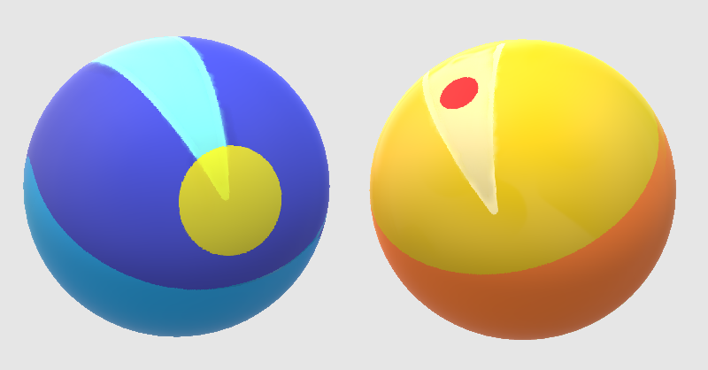
How is Data Analytics related to Big Data?
Relevant
Irrelevant
Signal
(relevant info)
Interpretable
Noise
(irrelevant info)
Noninterpretable
Interpretable Info
Insights
(novel info)
Uninterpretable Info
Big
Data
Information
(non-redundant
part of data)

Slide 3
Data Analytics Lifecycle
Customer Business Case
Analytics Objective
Target Outcome
Target Outcome Data
Customer Review
Explanatory Data
Data Integration
Data Exploration
Build Model
Test the Model
Review with Customer
Post-processing
Customer Review
Deploy Model
External Validation

Slide 4

What is Required by Data Analytics?
Integrate
Analyze
Visualize
V1 | V2 | V3 | V4
1 | 14.23 | 1.71 | 2.43
1 | 13.20 | 1.78 | 2.14
1 | 13.16 | 2.36 | 2.67
1 | 14.37 | 1.95 | 2.50
1 | 13.24 | 2.59 | 2.87

Slide 6

What in the World is Hadoop?
Hadoop is an open-source software framework for storing data and running applications on clusters of commodity hardware.
Allows to store and process big data in a distributed environment across clusters of computers using simple programming models.
It is designed to scale up from single servers to thousands of machines, each offering local computation and storage..

Slide 7
Where Did Hadoop Come From?
The genesis of Hadoop came from the Google File System paper [Ghemawat, Sanjay; Gobioff, Howard; Leung, Shun-Tak] that was published in October 2003.
This paper spawned another research paper from Google – MapReduce: Simplified Data Processing on Large Clusters. [Dean, Jeffrey; Ghemawat, Sanjay]
Development started in the Apache Nutch project, but was moved to the new Hadoop subproject in January 2006.
Doug Cutting, who was working at Yahoo! at the time, named it after his son's toy elephant.
The initial code that was factored out of Nutch consisted of 5k lines of code for Nutanix Distributed File System (NDFS) and 6k lines of code for MapReduce.
The first committer added to the Hadoop project was Owen O’Malley in March 2006.
Hadoop 0.1.0 was released in April 2006 and continues to evolve by the many contributors to the Apache Hadoop project.

Slide 8
What Comprises Hadoop?
The term Hadoop has come to refer not just to the base modules above, but also to the ecosystem, or collection of additional software packages that can be installed on top of or alongside Hadoop, such as:
Pig¹
Hive¹
HBase¹
Phoenix¹
Spark¹
ZooKeeper¹
HDFS
Cloudera Impala
Flume¹
Sqoop¹
Oozie¹
Storm¹
1. An Apache product

Slide 9
What are the Benefits of Hadoop?
Computing power: Its distributed computing model quickly processes big data. The more computing nodes you use, the more processing power you have.
Flexibility: Unlike traditional relational databases, you don’t have to preprocess data before storing it. You can store as much data as you want and decide how to use it later. That includes unstructured data like text, images and videos.
Fault tolerance: Data and application processing are protected against hardware failure. If a node goes down, jobs are automatically redirected to other nodes to make sure the distributed computing does not fail. And it automatically stores multiple copies of all data.
Low cost: The open-source framework is free and uses commodity hardware to store large quantities of data.
Scalability: You can easily grow your system simply by adding more nodes. Little administration is required.

Slide 10
What are the Components of Hadoop?
Hadoop Common – the libraries and utilities used by other Hadoop modules.
Hadoop Distributed File System (HDFS) – the Java-based scalable system that stores data across multiple machines without prior organization.
MapReduce – a software programming model for processing large sets of data in parallel.
YARN – resource management framework for scheduling and handling resource requests from distributed applications. (YARN is an acronym for Yet Another Resource Negotiator.)

Slide 11
What are the Components of Hadoop?
TEZ - Tez – Hindi for “speed” provides a general-purpose, highly customizable framework that creates simplifies data-processing tasks across both small scale (low-latency) and large-scale (high throughput) workloads in Hadoop.
It generalizes the MapReduce paradigm to a more powerful framework so that projects in the Apache Hadoop ecosystem such as Apache Hive, Apache Pig and Cascading can meet requirements for human-interactive response times and large scale output
MapReduce has been a key driver in achieving this functionality.

Slide 12
What are the Components of Hadoop?
Pig – a platform for manipulating data stored in HDFS that includes a compiler for MapReduce programs and a high-level language called Pig Latin. It provides a way to perform data extractions, transformations and loading, and basic analysis without having to write MapReduce programs.
Hive – a data warehousing and Structured Query Language (SQL)-like query language that presents data in the form of tables. Hive programming is similar to database programming. (It was initially developed by Facebook.)
Ambari – a web interface for managing, configuring and testing Hadoop services and components.

Slide 13
The Distributed File System: HDFS
The goal of Hadoop® is to use commonly available servers in a very large cluster, where each server has a set of inexpensive internal disk drives.
For higher performance, MapReduce tries to assign workloads to these servers where the data to be processed is stored. This is known as data locality.
To understand how it’s possible to scale a Hadoop® cluster to hundreds (and even thousands) of nodes, you have to start with the Hadoop Distributed File System (HDFS).
Data in a Hadoop cluster is broken down into smaller pieces (called blocks) and distributed throughout the cluster.
The map and reduce functions can be executed on smaller subsets of your larger data sets, and this provides the scalability that is needed for big data processing.

Slide 14
An example of HDFS
Think of a file that contains the phone numbers for everyone in the India; the people with a family name starting with A might be stored on server 1, B on server 2, and so on.
In a Hadoop world, pieces of this phone directory would be stored across the cluster, and to reconstruct the entire phonebook, your program would need the blocks from every server in the cluster.
To achieve availability as components fail, HDFS replicates these smaller pieces onto two additional servers by default.
This redundancy can be increased or decreased on a per-file basis or for a whole environment; for example, a development Hadoop cluster typically doesn’t need any data re­dundancy.
This redundancy offers multiple benefits, the most obvious being higher availability.
In addition, this redundancy allows the Hadoop cluster to break work up into smaller chunks and run those jobs on all the servers in the cluster for better scalability.
Finally, you get the benefit of data locality, which is critical when working with large data sets.

Slide 15
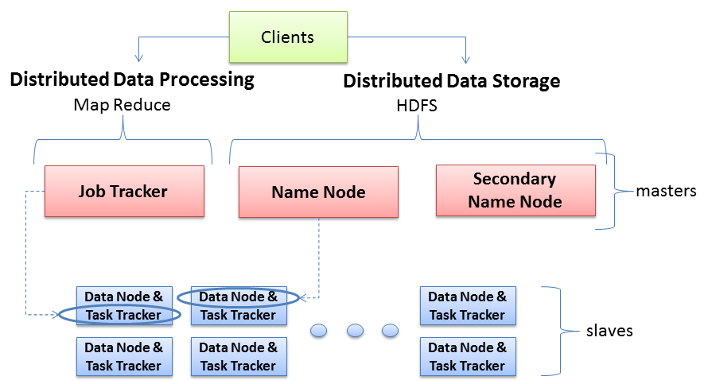
Hadoop Server Roles
NameNode stores MetaData (No of Blocks, On Which Rack which DataNode the data is stored and other details) about the data being stored in DataNodes whereas the DataNode stores the actual Data.
Secondary NN contains the name space image, edit log files' back up for past one hour (configurable). And its work is to merge latest Name Node NameSpaceImage and edit logs files to upload back to Name Node as replacement of the old one
Technical Sense: JobTracker is a master which creates and runs the job. JobTracker which can run on the NameNode allocates the job to TaskTrackers which run on DataNodes; TaskTrackers run the tasks and report the status of task to JobTracker.
two key functional pieces
Oversees and coordinates the parallel processing of data
Oversees and coordinates the data storage function (HDFS)
Physical Sense: The JobTracker runs on MasterNode aka NameNode whereas TaskTrackers run on DataNodes.

Slide 16
Example - Typical Hadoop cluster setup for 4500 nodes
110 different racks
Each rack would have around 40 slave machine
At the top of each rack there is a rack switch
Each slave machine(rack server in a rack) has cables coming out it from both the ends
Cables are connected to rack switch at the top which means that top rack switch will have around 80 ports
There are global 8 core switches
The rack switch has uplinks connected to core switches and hence connecting all other racks with uniform bandwidth, forming the Cluster
In the cluster, you have few machines to act as Name node and as JobTracker. They are referred as Masters. These masters have different configuration favoring more DRAM and CPU and less local storage.
The majority of the machines acts as DataNode and Task Trackers and are referred as Slaves. These slave nodes have lots of local disk storage and moderate amounts of CPU and DRAM

Slide 17
Typical Workflow
Load data into the cluster (HDFS writes)
Analyze the data (Map Reduce)
Store results in the cluster (HDFS writes)
Read the results from the cluster (HDFS reads)
Sample Scenario
How many times did our customers type the word
“Refund” into emails sent to our customer service?
Huge file containing all emails
sent to customer service
Email.txt

Slide 18
Writing Files to HDFS
Okay. Write Data Nodes 1,5,6
I want to write Blocks A,B,C of Email.txt
Client
Name Node
Blk A
Blk B
Blk C
Data Node 1
Data Node 2
Data Node 3
Data Node N
Blk A
Blk B
Blk C

Slide 19
Preparing HDFS Writes
Okay. Write Data Nodes 1,5,6
I want to write Blocks A,B,C of Email.txt
Email.txt
Client
Name Node
Blk A
Blk B
Blk C
switch
Rack 1:
Data Node 1
Rack 5:
Data Node 5
Data Node 6
Ready Data Nodes 5,6
switch
switch
Data Node 1
Data Node 5
Ready Data Node 6
Name Node picks two nodes in the same rack, one node in a different rack
Data protection
Locality for M/R
Data Node 6
Ready?
Rack 1
Rack 5

Slide 20
Contact Information
E-mail: jeff@humalytica.com
LinkedIn: https://www.linkedin.com/in/jeffreystrickland
Web site: www.humalytica.com
Skype: jeffrey.strickland2

